Slide 1

jeopardytemplatepowerpoint.com
Flowering Plants Structure

Slide 2


15
€1,000,000
 | ♦
 | ♦
 | ♦
 | ♦
 | ♦
 | ♦
 | ♦
 | ♦
 | ♦
 | ♦
 | ♦
 | ♦
 | ♦
 | ♦
 | ♦
14
€ 500,000
13
€ 250,000
12
€ 125,000
11
€ 64,000
10
€ 32,000
9
€ 16,000
8
€ 8,000
7
€ 4,000
6
€ 2,000
5
€ 1,000
4
€ 500
3
€ 300
2
€ 200
1
€ 100

Slide 3

Are you ready?
Click here to continue

Slide 4
For €100:
The part of the plant that anchors it in
the ground is the …
50:50 Ask the audience Phone a friend
Stem
Leaf
A
B
Bud
Root
C
D

Slide 5


D: Root
You have won €100
Next Question

Slide 6
For €100:
The part of the plant that anchors it in
the ground is the …
Ask the audience Phone a friend
A
B
Bud
Root
C
D

Slide 7
Ask the audience
Back to question

Slide 8
Phone a friend
Hello, it's Chris Tarrant on Who wants to be a millionaire, this question is for €100.
It has to be D Chris
Back to question

Slide 9
For €200:
The function of vascular tissue is …
50:50 Ask the audience Phone a friend
Transport
Protection
A
B
Photosynthesis
Reproduction
C
D

Slide 10

A: Transport
You have won €200
Next Question

Slide 11
For €200:
The function of vascular tissue is …
Ask the audience Phone a friend
Transport
A
B
Photosynthesis
C
D

Slide 12
Ask the audience
Back to question

Slide 13
Phone a friend
Hello, it's Chris Tarrant on Who wants to be a millionaire, this question is for €200.
It’s definitely A Chris
Back to question

Slide 14
For €300:
Which tissue type is responsible for
cell division?
50:50 Ask the audience Phone a friend
Vascular
Meristematic
A
B
Dermal
Ground
C
D

Slide 15
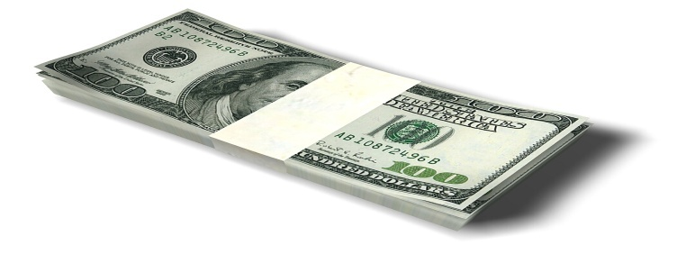
B: Meristematic
You have won €300
Next Question

Slide 16
For €300:
Which tissue type is responsible for
cell division?
Ask the audience Phone a friend
Vascular
Meristematic
A
B
C
D

Slide 17
Ask the audience
Back to question

Slide 18
Phone a friend
Hello, it's Chris Tarrant on Who wants to be a millionaire, this question is for €300.
I’m 80% certain that it's … B
Back to question

Slide 19
For €500:
Two types of vascular tissue are …
50:50 Ask the audience Phone a friend
Phloem and Ground
Xylem and Phloem
A
B
Xylem and Ground
Phloem and Dermal
C
D

Slide 20
B: Xylem and Phloem
You have won €500
Next Question

Slide 21
For €500:
Two types of vascular tissue are …
Ask the audience Phone a friend
Xylem and Phloem
A
B
Xylem and Ground
C
D

Slide 22
Ask the audience
Back to question

Slide 23
Phone a friend
Hello, it's Chris Tarrant on Who wants to be a millionaire, this question is for €500.
That’s definitely B
Back to question

Slide 24
For €1,000:
Which of the following is not a
flowering plant?
50:50 Ask the audience Phone a friend
Daffodil
Buttercup
A
B
Grass
None of these
C
D

Slide 25
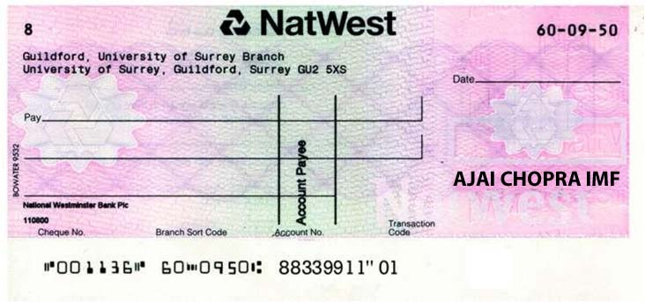
Congratulations
D: None of these
You have won €1,000.00
7-Feb-17
The Contestant
One thousand euro only
€ 1,000.00
Next Question

Slide 26
For €1,000:
Which of the following is not a
flowering plant?
Ask the audience Phone a friend
A
B
Grass
None of these
C
D

Slide 27
Ask the audience
Back to question

Slide 28
Phone a friend
Hello, it's Chris Tarrant on Who wants to be a millionaire, this question is for €1,000.
I really don’t know this one, just let me think ...
Back to question

Slide 29
For €2,000:
Phloem transports …
50:50 Ask the audience Phone a friend
Water
Starch
A
B
Sucrose
Minerals
C
D

Slide 30

C: Sucrose
You have won €2,000
Next Question

Slide 31
For €2,000:
Phloem transports …
Ask the audience Phone a friend
Starch
A
B
Sucrose
C
D

Slide 32
Ask the audience
Back to question

Slide 33
Phone a friend
Hello, it's Chris Tarrant on Who wants to be a millionaire, this question is for €2,000.
I know this one, it's … B, I think
Back to question

Slide 34
For €4,000:
Lenticels are used to …
50:50 Ask the audience Phone a friend
Absorb water
Exchange gases
A
B
Strengthen xylem
Transport water
C
D

Slide 35

B: Exchange gases
You have won €4,000
Next Question

Slide 36
For €4,000:
Lenticels are used to …
Ask the audience Phone a friend
Exchange gases
A
B
Strengthen xylem
C
D

Slide 37
Ask the audience
Back to question

Slide 38
Phone a friend
Hello, it's Chris Tarrant on Who wants to be a millionaire, this question is for €4,000.
It is definitely A ... Wait a minute it may be C
Back to question

Slide 39
For €8,000:
Roots are adapted for water
absorption by having …
50:50 Ask the audience Phone a friend
Hairs
Cuticle
A
B
Stoma
None of these
C
D

Slide 40

A: Hairs
You have won €8,000
Next Question

Slide 41
For €8,000:
Roots are adapted for water
absorption by having …
Ask the audience Phone a friend
Hairs
Cuticle
A
B
C
D

Slide 42
Ask the audience
Back to question

Slide 43
Phone a friend
Hello, it's Chris Tarrant on Who wants to be a millionaire, this question is for €8,000.
I am not sure, I would guess A
Back to question

Slide 44
For €16,000:
Dicotyledonous plants have …
50:50 Ask the audience Phone a friend
Parallel veins
Tap roots
A
B
Fibrous roots
Strap leaves
C
D

Slide 45

B: Tap roots
You have won €16,000
Next Question

Slide 46
For €16,000:
Dicotyledonous plants have …
Ask the audience Phone a friend
Tap roots
A
B
Fibrous roots
C
D

Slide 47
Ask the audience
Back to question

Slide 48
Phone a friend
Hello, it's Chris Tarrant on Who wants to be a millionaire, this question is for €16,000.
I am not sure, I’d chance B
Back to question

Slide 49
For €32,000:
In which tissue type would you
find tracheids?
50:50 Ask the audience Phone a friend
Phloem
Dermal
A
B
Xylem
Ground
C
D

Slide 50
C: Xylem
You have won €32,000
7-Feb-17
The Contestant
Thirty two thousand euro only
€ 32,000.00
Next Question

Slide 51
For €32,000:
In which tissue type would you
find tracheids?
Ask the audience Phone a friend
Phloem
A
B
Xylem
C
D

Slide 52
Ask the audience
Back to question

Slide 53
Phone a friend
Hello, it's Chris Tarrant on Who wants to be a millionaire, this question is for €32,000.
I believe it is … A
Back to question

Slide 54
For €64,000:
One of the Irish Scientists credited with
the Cohesion-tension model of
water movement in plants is …
50:50 Ask the audience Phone a friend
Watson
Wallace
A
B
Darwin
Dixon
C
D

Slide 55
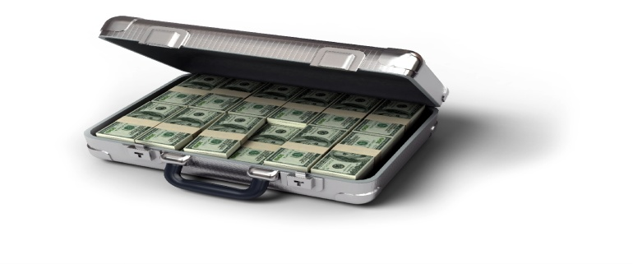
D: Dixon
You have won €64,000
Next Question

Slide 56
For €64,000:
One of the Irish Scientists credited with
the Cohesion-tension model of
water movement in plants is …
Ask the audience Phone a friend
A
B
Darwin
Dixon
C
D

Slide 57
Ask the audience
Back to question

Slide 58
Phone a friend
Hello, it's Chris Tarrant on Who wants to be a millionaire, this question is for €64,000.
I think it is C or D. I’m nor sure which. Take a chance on D.
Back to question

Slide 59
For €125,000:
The gas that controls stomatal
opening is …
50:50 Ask the audience Phone a friend
O₂
H₂O
A
B
CO₂
N₂
C
D

Slide 60

C: CO₂
You have won €125,000
Next Question

Slide 61
For €125,000:
The gas that controls stomatal
opening is …
Ask the audience Phone a friend
O₂
A
B
CO₂
C
D

Slide 62
Ask the audience
Back to question

Slide 63
Phone a friend
Hello, it's Chris Tarrant on Who wants to be a millionaire, this question is for €125,000.
I know it. Oh! Chance C or D
Back to question

Slide 64
For €250,000:
In which tissue type would you find
chloroplasts?
50:50 Ask the audience Phone a friend
Phloem
Ground
A
B
Dermal
Xylem
C
D

Slide 65

B: Ground
You have won €250,000
Next Question

Slide 66
For €250,000:
In which tissue type would you find
chloroplasts?
Ask the audience Phone a friend
Phloem
Ground
A
B
C
D

Slide 67
Ask the audience
Back to question

Slide 68
Phone a friend
Hello, it's Chris Tarrant on Who wants to be a millionaire, this question is for €250,000.
It’s either A or B, I’m 100% certain of that.
Back to question

Slide 69
For €500,000:
What chemical strengthens the
walls of xylem?
50:50 Ask the audience Phone a friend
Cellulose
Lignin
A
B
Chitin
Keratin
C
D

Slide 70
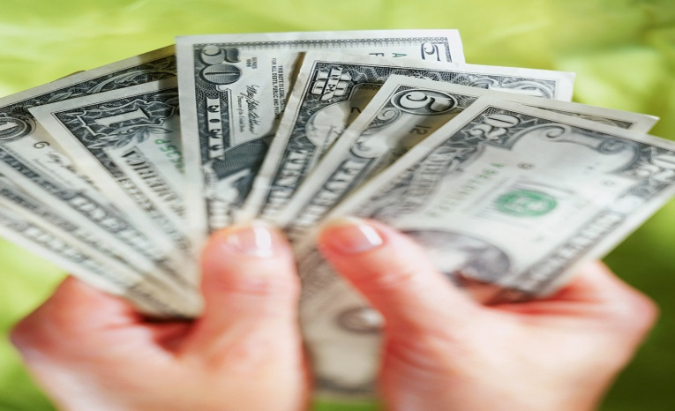
B: Lignin
You have won €500,000
Next Question

Slide 71
For €500,000:
What chemical strengthens the
walls of xylem?
Ask the audience Phone a friend
Cellulose
Lignin
A
B
C
D

Slide 72
Ask the audience
Back to question

Slide 73
Phone a friend
Hello, it's Chris Tarrant on Who wants to be a millionaire, this question is for €500,000.
I know this? Is it B?
Back to question

Slide 74
50:50 Ask the audience Phone a friend
For €1,000,000:
Name a type of modified stem that
functions in food storage.
Carrot
Potato
A
B
Bulb
Tuber
C
D

Slide 75
Congratulations
You are a Millionaire!
7-Feb-17
The Contestant
One million euro only
€ 1,000,000.00

Slide 76
Ask the audience Phone a friend
For €1,000,000:
Name a type of modified stem that
functions in food storage.
Potato
A
B
Tuber
C
D

Slide 77
Ask the audience
Back to question

Slide 78
Phone a friend
Hello, it's Chris Tarrant on Who wants to be a millionaire, this question is for €1,000,000.
I do not have a clue I’m afraid
Back to question

Slide 79
WRONG ANSWER
Hard Luck
You leave with nothing
Try Again

Slide 80
WRONG ANSWER
Hard Luck
You leave with a cheque for €1,000.00
Try Again
7-Feb-17
The Contestant
One thousand euro only
€ 1,000.00

Slide 81
WRONG ANSWER
Hard Luck
You leave with a cheque for €32,000.00
Try Again
7-Feb-17
The Contestant
Thirty two thousand euro only
€ 32,000.00

